Slide 1
Lesson 4 ADC
任课教师：刘昱朗
Email: yulangliu@hotmail.com

Slide 2
Outline
Technical Contents
Analog signal 模拟信号
Digital signal 数字信号
ADC (Analog-to-digital converter) 模数转换器
Technical Terms

Slide 3
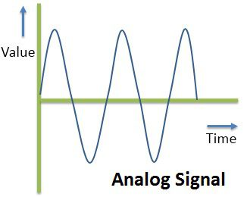
Analog signal
An analog signal is a continuous signal that contains time-varying quantities.

Slide 4
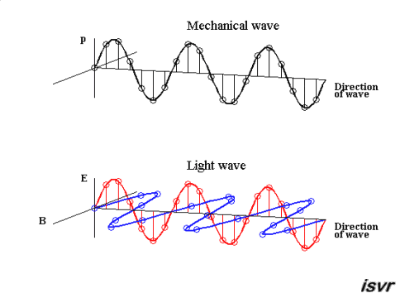
Analog signal
An analog signal is a continuous signal that contains time-varying quantities.

Slide 5
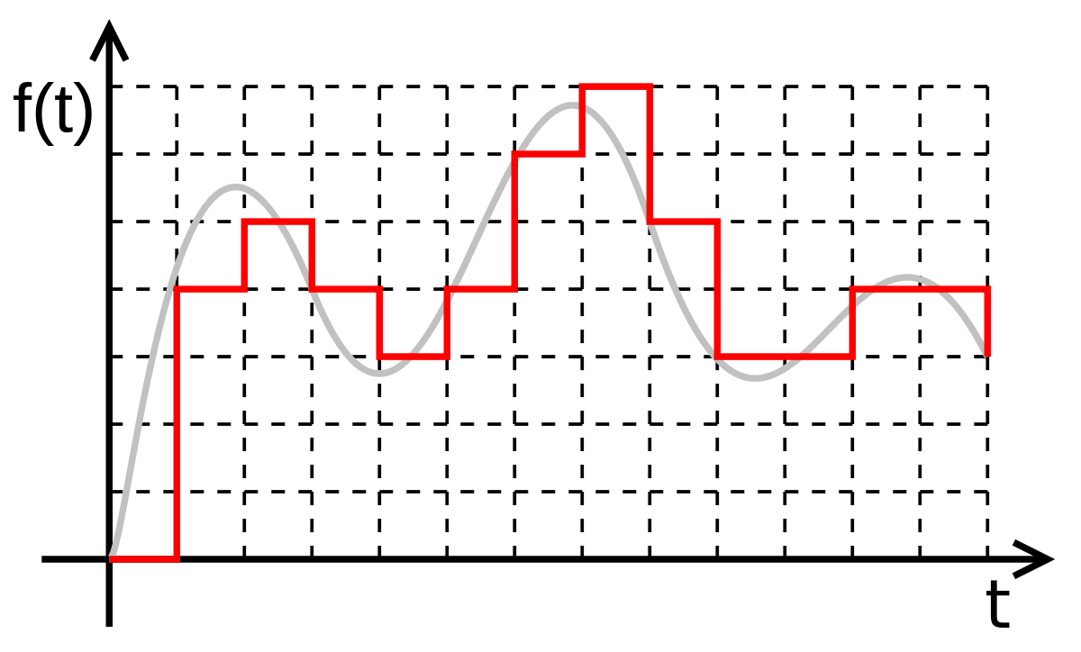
Digital signal
A digital signal refers to an electrical signal that is converted into a pattern of bits

Slide 6
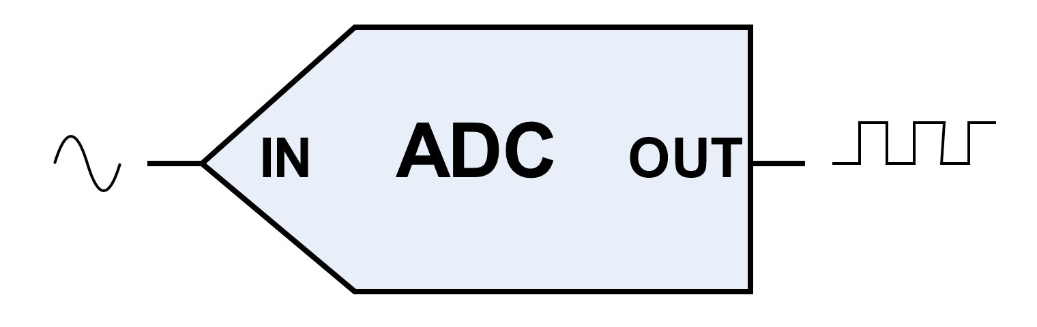
Analog-to-Digital Converter
ADC is a system that converts an analog signal, such as a sound picked up by a microphone or light entering a digital camera, into a digital signal.

Slide 7
Analog-to-Digital Converter

Slide 8
Analog-to-Digital Converter

Slide 9
Digital signal
MP3 file
Use Matlab to show what is an MP3 file

Slide 10
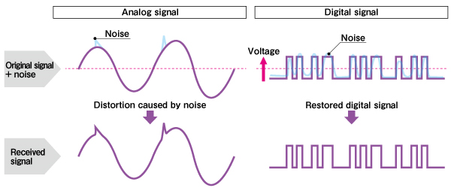
Why Digital Signal
Noise Immunity

Slide 11
Why Digital Signal
Multiplexing: Digital signals are better suited than analog signals for processing and combining using a technique multiplexing.
Easy to Store: It is simple to store digital signals than analog signals.
Transmission errors can be detected easily: The transmission errors can be detected and corrected more easily and accurately than is possible with analog signals.

Slide 12
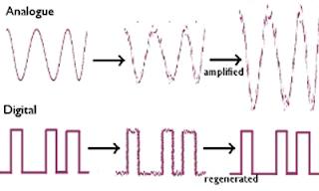
Analog-to-Digital Converter
Resistant to additive Noise: Digital transmission systems are more resistant to analog system to additive noise because they use signal regeneration rather than signal amplification.

Slide 13
Technical Terms
LSB (least significant bit) 最低有效位
reference voltage 参考电压
sampling rate 采样率
full scale 满量程
FFT abbr. Fast Fourier Transform 快速傅里叶变换
resolution 分辨率
accuracy 精度
interpolation 插值

Slide 14
Structures and Sentences
If we were to digitally filter this sampled signal, we could remove approximately ¾ of the noise, increasing the SNR by a factor of 4 or 6 dB.
假如我们对采样后的信号做数字滤波，我们就可以去掉约3/4的噪声，从而将信噪比提高4-6dB。

